Slide 1
“What is the greatest difficulty, refugee students face in the process of integration in their host countries?”
Question to answer in the chat:
What languages are spoken by the people in your classroom?
Jake Rose-Brown
Teacher & Co-founder of A Day of Welcome
Notes:
Context is key. Let you know about my journey as an educator in relation to refugee education and integration.

Slide 2
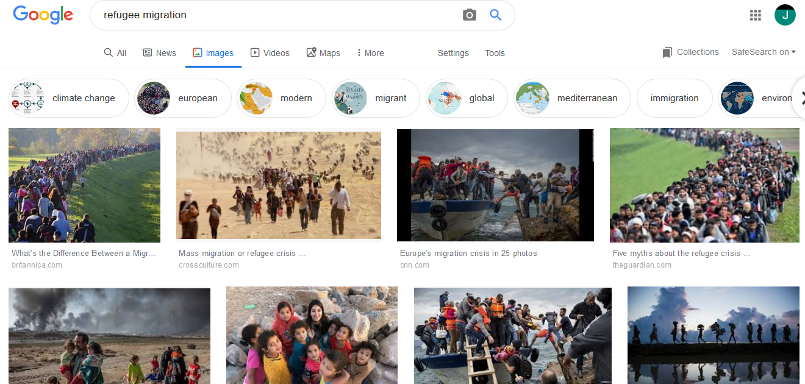
How should schools respond to the ‘refugee crisis’?

Slide 3
City of Sanctuary is a grassroots movement in the UK committed to building a culture of hospitality and welcome, especially for refugees seeking sanctuary from war and persecution.
Notes:
My journey to CoS. Context. Places of sanctuary in N – UEA, arts centre, Unitarian Chapel, bar, restaurant, Norfolk Knitters, Also open to Norfolk.

Slide 4
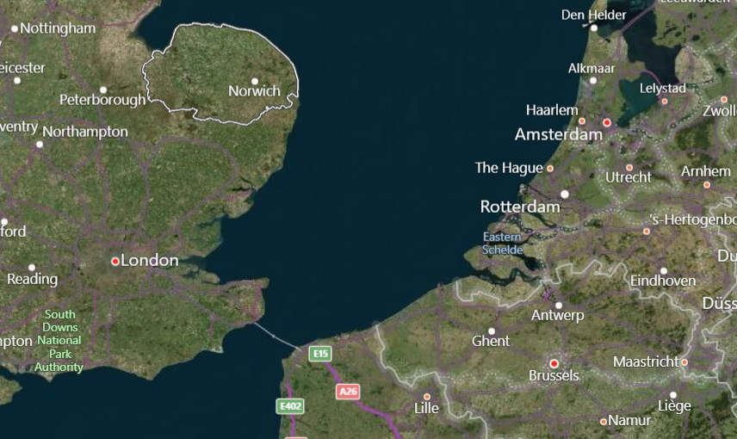
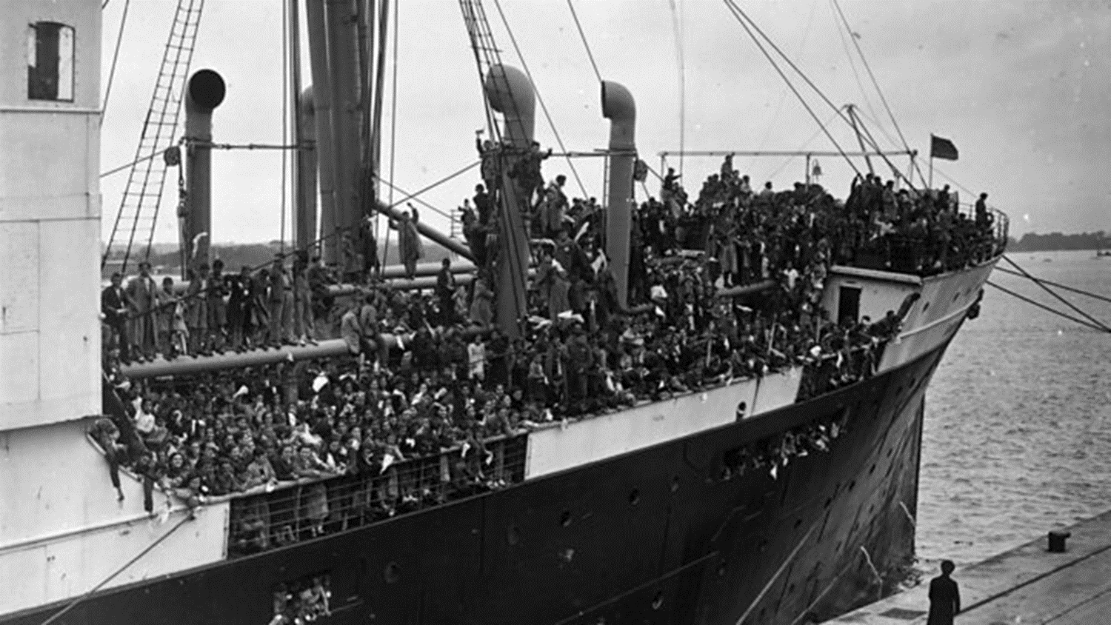

Slide 6
What is the greatest difficulty, refugee students face in the process of integration in their host countries?
Barriers to integration
TRAUMA &
A LACK OF CONTROL
FOSTERING A SENSE OF BELONGING
ACCESSING PRACTICAL SUPPORT
LACK OF AWARENESS
LANGUAGE
There is no single story!
Local context is key
Support the family to support the children
Notes:
Case study – Anya’s family

